Slide 1
Week 5-7 Onepot PURE
1.Culture bacteria strain
2. Protein purification
3. Concentration adjustment

Slide 2
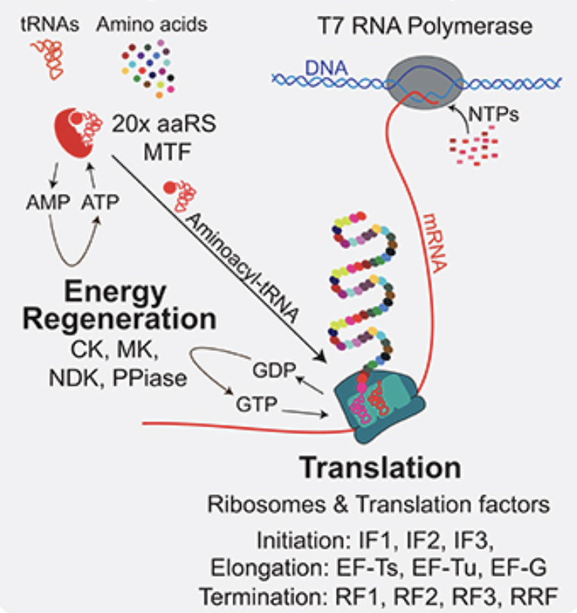
PURE

Slide 3
36 proteins

Slide 4
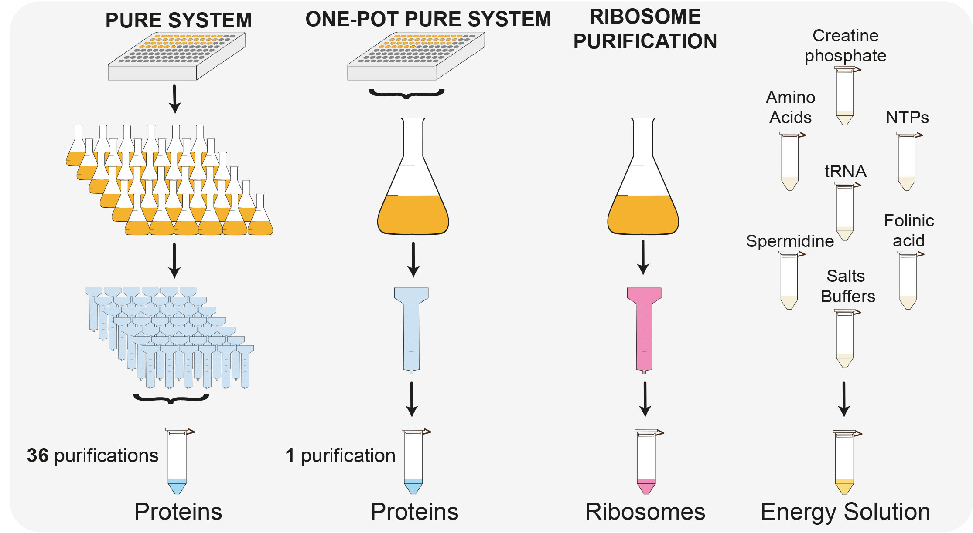

Slide 5
Cell culture
Induce cell culture (36 strains co-culture)
preparing the co-culture
  55 µl of each strains
  1675 µl of EF-Tu strain (No.25)

Slide 6
Buffer preparation
Protein solution purification components | Stock solution |  | Buffer A |  |  |  | Buffer B |  |  |  | Buffer HT
 | MW [g/mol] | Concentration [M] | concentration |  | volume |  | concentration |  | volume |  | concentration |  | volume
HEPES** |  | 1 | 50 | mM | 25 | mL | 50 | mM | 25 | mL | 50 | mM | 10 | mL
Ammonium chloride* | 53.49 | 1 | 1000 | mM | 26.7 | g
Magnesium chloride |  | 1 | 10 | mM | 5 | mL | 10 | mM | 5 | mL | 10 | mM | 2 | mL
Potassium chloride | 74.55 | 2 |  |  |  |  | 100 | mM | 25 | mL | 100 | mM | 10 | mL
Imidazole (pH=7) | 68.08 | 1 |  |  |  |  | 500 | mM | 250 | mL
Glycerol
TCEP** |  | 0.5 | 1 | mM | 1 | mL | 1 | mM | 1 | mL | 1 | mM | 0.4 | mL
total buffer volume |  |  |  |  | 500 | mL |  |  | 500 | mL |  |  | 200 | mL

Slide 7
Week 6 Protein purification

Slide 8
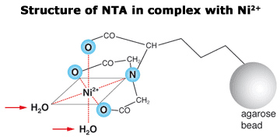
Protein His-tagged Purification

Slide 9
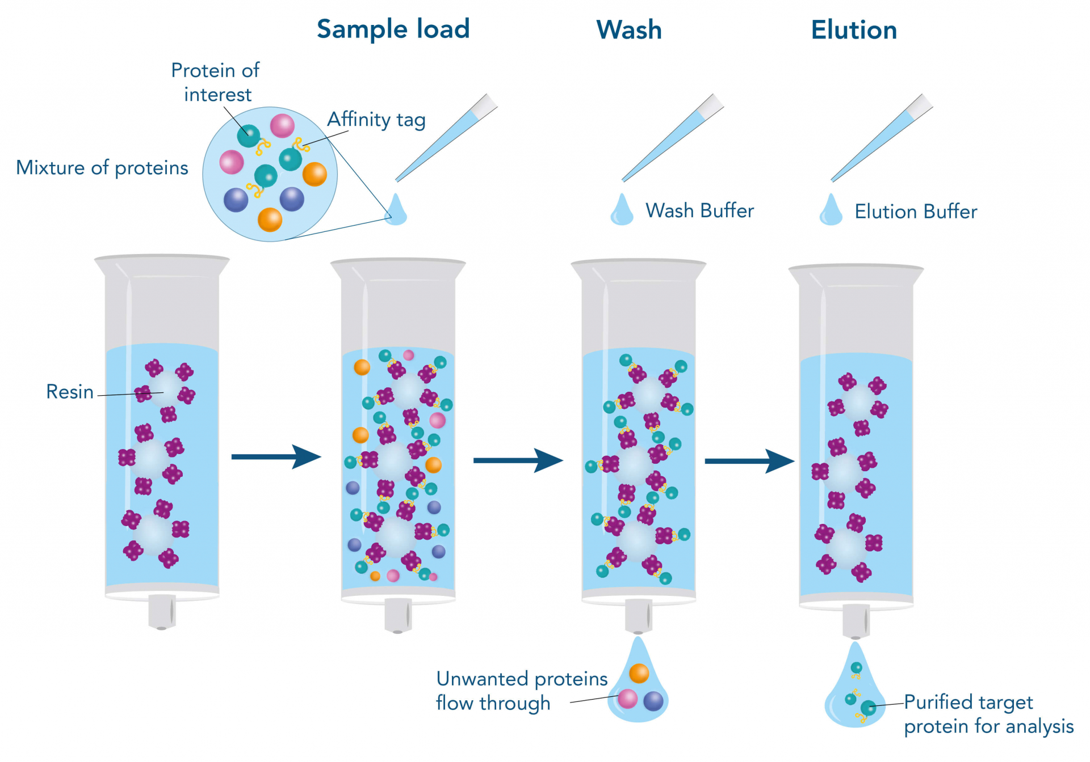

Slide 10
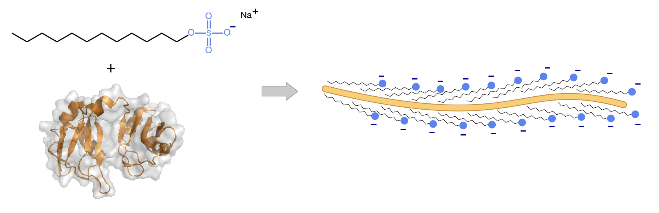
SDS-PAGE(sodium dodecyl sulfate–polyacrylamide gel electrophoresis)

Slide 11
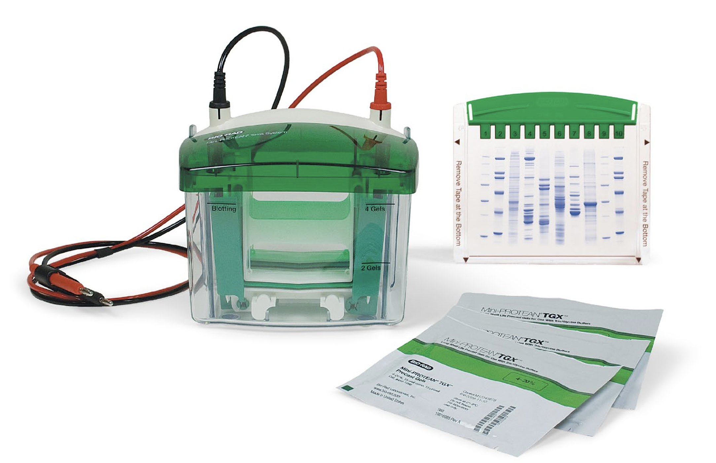

Slide 12
SDS-PAGE
Add 2x denaturing buffer
Incubate at 95˚C for 5 minutes
Load samples to the gel
Run with 200V for 35 minutes
Stain the gel with Commasie blue for 1 hour.

Slide 13
